Slide 1
ONR NGO Climate Change Workshop
London
1 July 2025

Slide 2
Agenda
Topic | Time
Arrival and refreshments | 9.30 – 10.00
Opening introductions | 10.00 – 10.15 | Co-Chairs – Sarah Brown (ONR) and Katy Attwater (NGOs)
Climate Change Summary report update Overview of the CNI themed inspection – purpose, aims and scope Findings and themes Ongoing work on climate change – engagement with other regulators, DEFRA reporting | 10.15 – 11.45 | Teresa Montaner Calatrava Rachel Kirley
Break | 11:45 – 12:00
Climate Change Work continued Interactive session based on NGO answers to questions | 12:00 – 13:00 | Teresa Montaner Calatrava Rachel Kirley
Lunch | 13:00 – 14:00
ONR’s Research on External Hazards – Recent updates | 14:00 – 15:00 | Teresa Montaner Calatrava Rachel Kirley
Future of climate change workshops – general discussion |  | Co-Chairs – Sarah Brown (ONR) and Katy Attwater (NGOs)
Summary of the day | 15:00 – 15:30 | Co-Chairs – Sarah Brown (ONR) and Katy Attwater (NGOs)

Slide 3
CNI Themed Inspection on Climate Change – NGO Forum – Session 1
Date: 1 July 2025

Slide 4
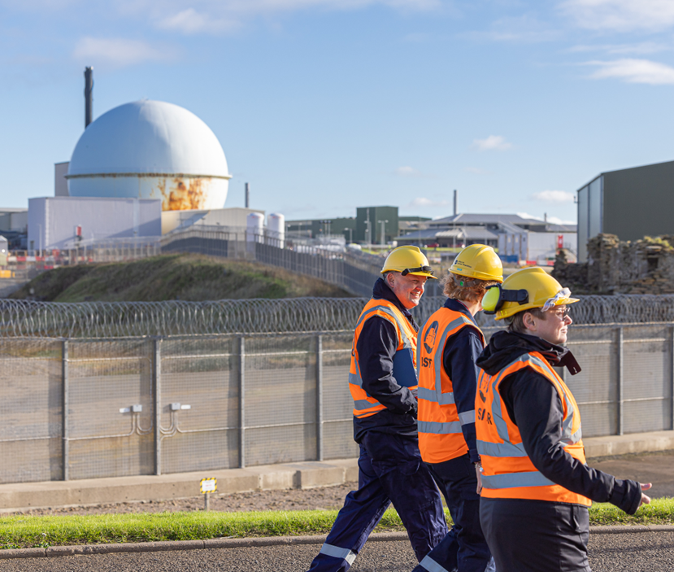
Overview
Overview of the CNI themed inspection on climate change
Findings and themes
Other ongoing work on climate change

Slide 5
Overview of Chief Nuclear Inspector’s Themed Inspection on Climate Change

Slide 6
CNI Themed Inspections – Overview
Purpose of CNI Themed Inspections:
  Examine regulatory matters of specific strategic interest
  Provide assurance to the Chief Nuclear Inspector (CNI)
  Raise awareness of important issues to a wider audience
  Provide confidence to a broad range of national and international stakeholders

Slide 7
CNI Themed Inspections – Overview
Introduced in 2017
Each is commissioned by the CNI
Two completed
Supply Chain Management Arrangements, 2018
Typical features
Engagement at a senior level
Covering a strategic issue
Management of ageing facilities, 2022
Often multiple sites or dutyholders
Include additional stakeholders

Slide 8
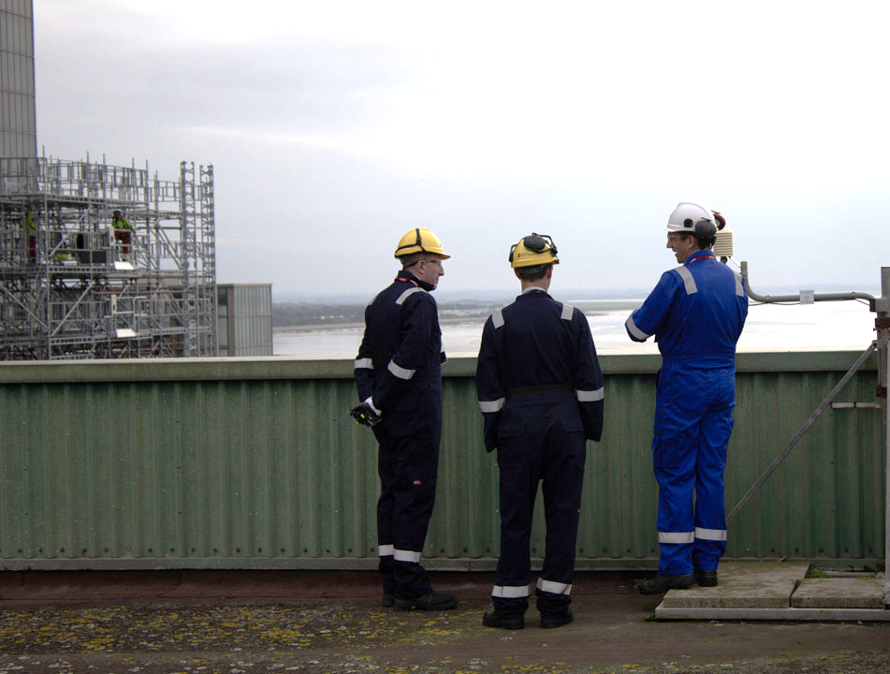
Reasons for the CNI Themed Inspection on Climate Change
  Recognition of the growing challenges presented by climate change
  Significant public interest
  Provide assurance
  Identify areas of good practice and improvement

Slide 9
Aim of the CNI Themed Inspection on Climate Change
Aim of inspection was to seek assurance that the nuclear industry within Great Britain:
  Understands and has taken account of recent climate change projections
  Can demonstrate that activities will remain safe and secure in the future
  Has effective arrangements to monitor and review climate change information, to determine whether additional measures might be needed

Slide 10
CNI Themed Inspection on Climate Change – Scope
Self-assessment questionnaire
We requested that licensees, prospective licensees and requesting parties complete this, providing information on their arrangements and resilience in relation to climate change effects.
Site-based inspections
Site-based regulatory inspections were conducted by ONR. The sites selected for inspection were informed by the content of the self-assessment questionnaires. They examined the effectiveness by which sites implement the arrangements described in the self-assessment, and the extent to which these arrangements aligned with relevant good practice.
Summary Report
Following completion of the selected site-based regulatory inspections, we will publish a Summary Report of the findings, consistent with previous CNI Themed Inspections.

Slide 11
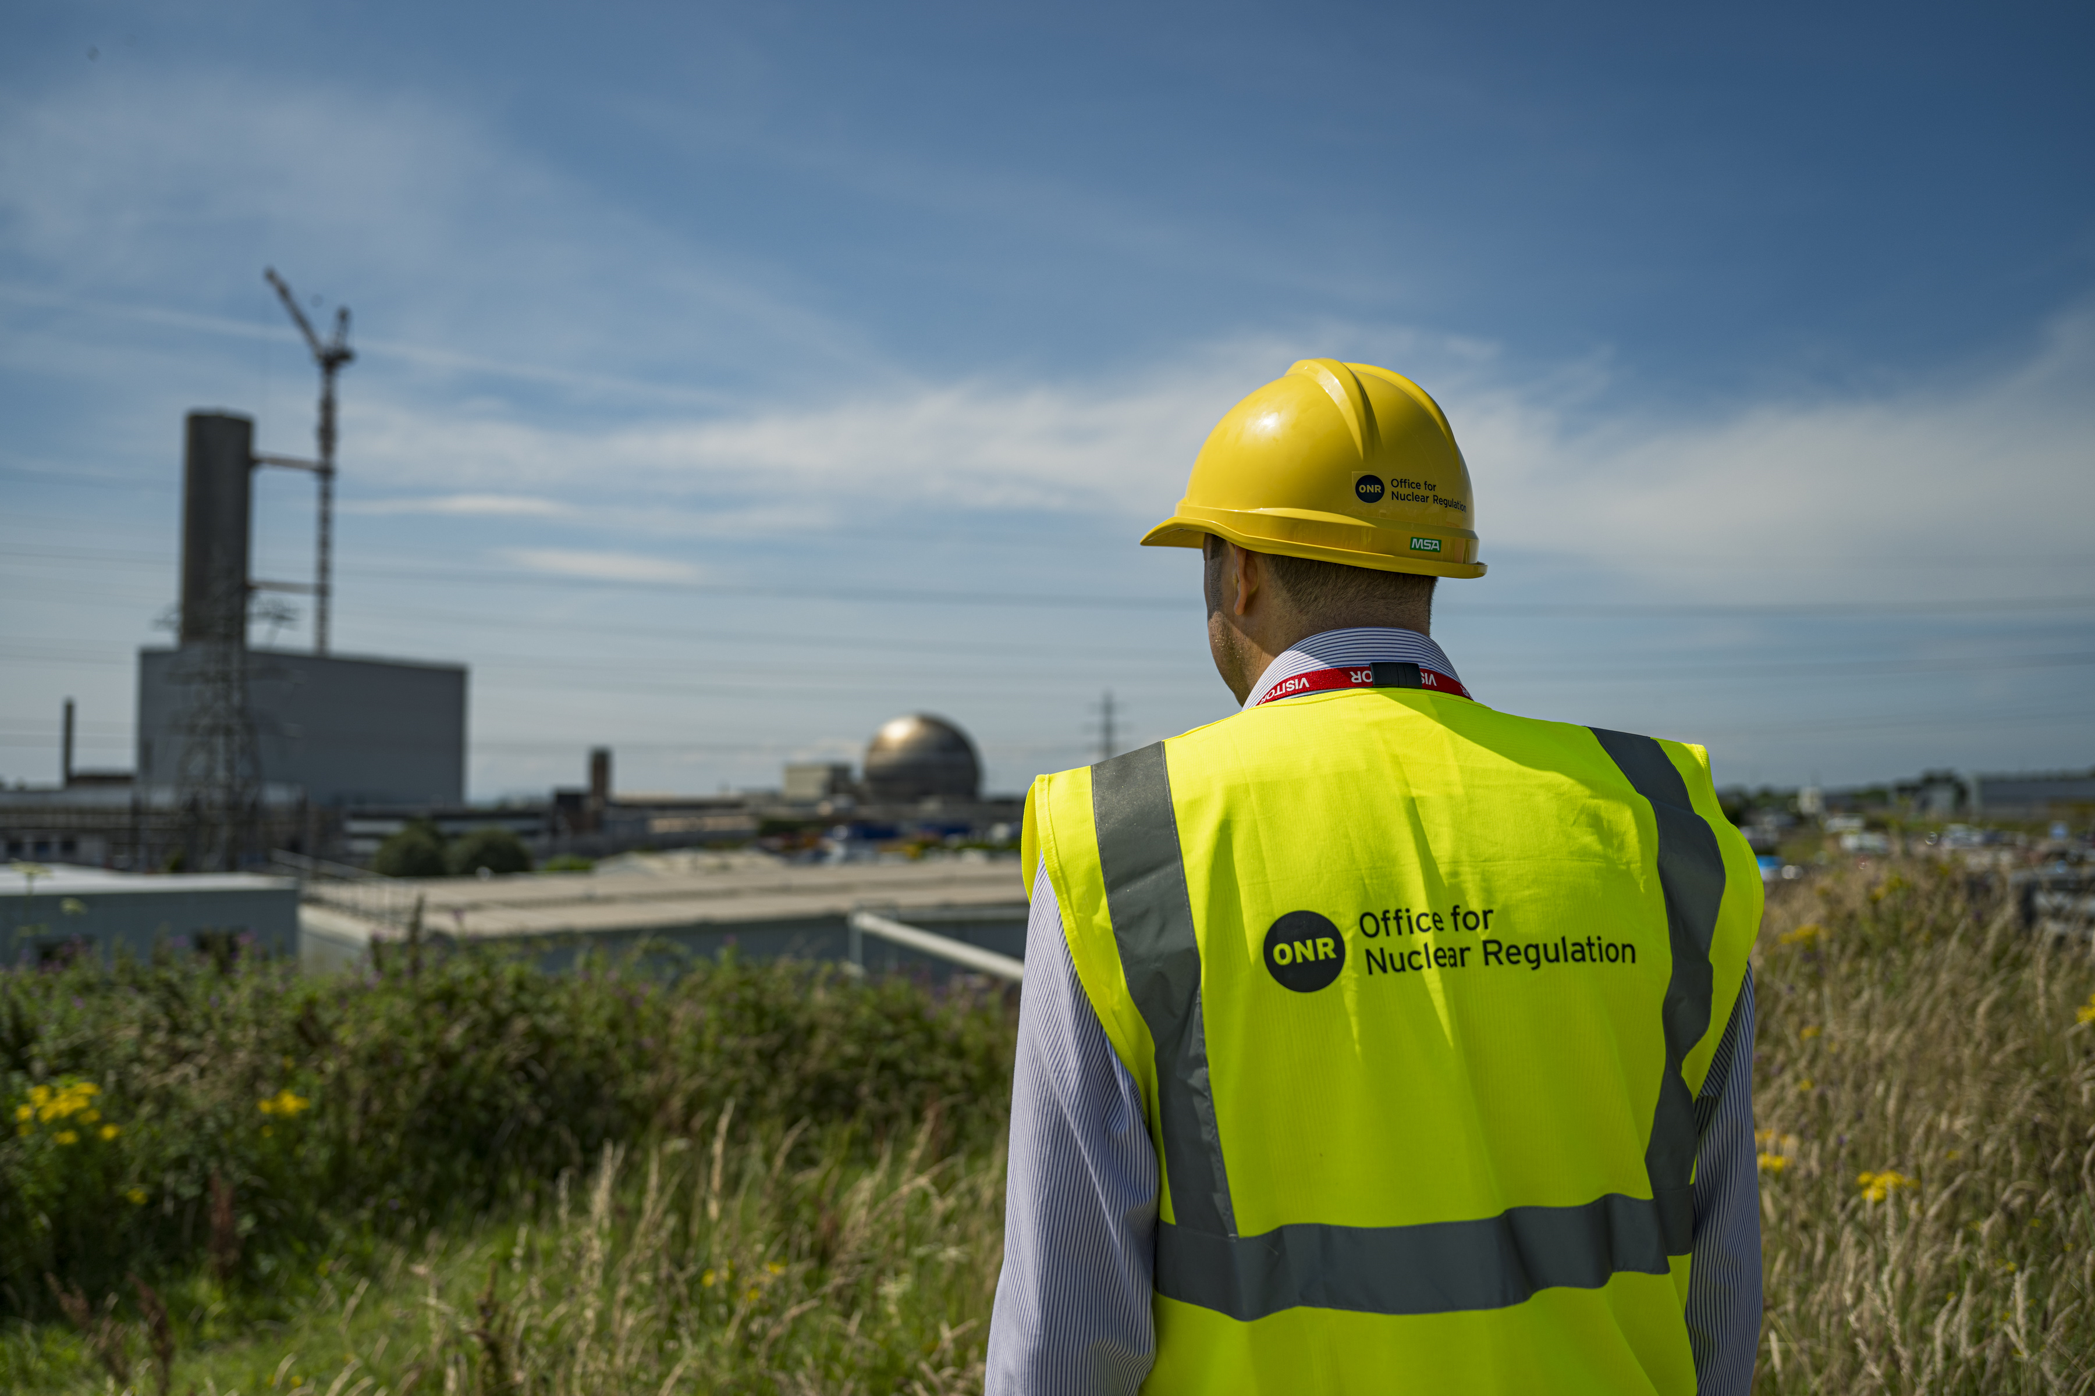
Self-assessment responses
Questionnaire sent out by ONR end of June 2023.
Responses received from all stakeholders written to by end October 2023.
Due to GDA stage, Rolls Royce SMR Ltd. did not participate.
Inutec Ltd, Cyclife UK Ltd and GE Healthcare Amersham were not asked to provide a response due to the nature of their activities and the lower radiological risk at these sites.
11

Slide 12
Results from Self-Assessment Questionnaires (1/2)
12

Slide 13
Results from Self-Assessment Questionnaires (2/2)
13

Slide 14
Site-based inspections
The aim of the site-based inspections was to provide greater insight into how licensees are managing climate change effects and associated risks as well as identifying learning for both industry and ONR.
5 sites selected - AWE, Dounreay, Heysham 2, Sellafield, Sizewell B
Consistent agenda, with site-specific focus areas identified for each site
Spread out the inspections among External Hazards team members. Supported by senior leadership.
We captured learning as either ‘constructive’ or ‘good practice’ learning points
14

Slide 15
Inspection approach
Not a licence condition compliance inspection or system-based inspection.
At the end of each inspection, ONR formed an overarching judgement on whether its regulatory expectations in relation to climate change have:
  been met
  been partially met and/or there are plans in place to ensure that they are met
  not been met and there are no current plans in place to ensure that they are met
This judgement took account of ONR SAPs, and RGP such as TAG 13, and joint regulatory climate change guidance.
15

Slide 16
Outcomes of inspection phase
Five inspections completed between June-October 2024.
  NDA observed two inspections – Sellafield and Dounreay.
  Environment Agency joined all four inspections at English sites.
  DNSR joined one inspection at AWE.
ONR judgements on whether its regulatory expectations in relation to climate change have been met/partially met/not met:
  4 inspections – Partially met with plans in place to ensure they are met
  1 inspection – ONR’s expectations have been met
16

Slide 17
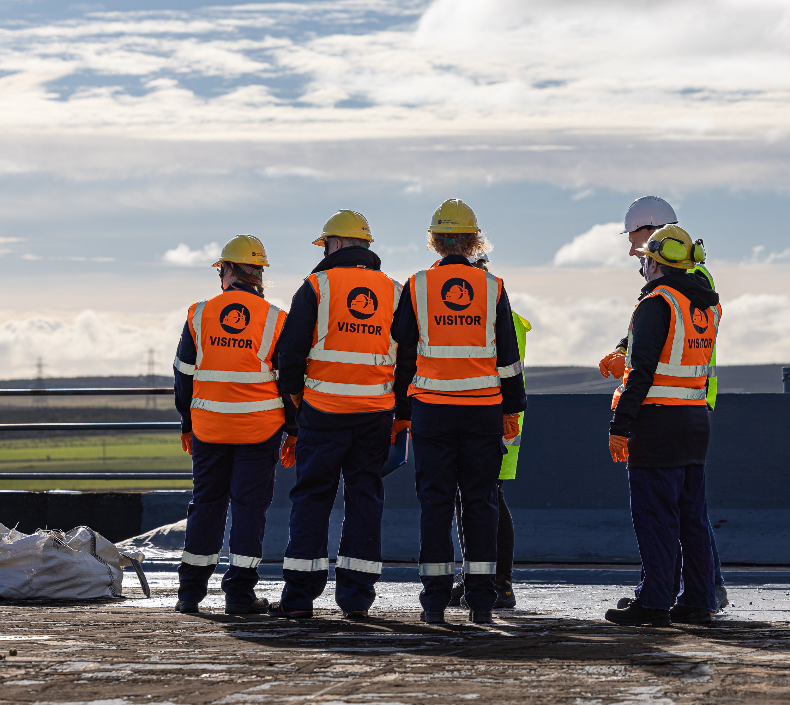
Summary Report
Collated findings from the CNI Themed Inspection on Climate Change, including self-assessment questionnaire and inspection phases.
Will be published on ONR’s website in due course.
17

Slide 18
Findings and Themes

Slide 19
Key finding of the CNI Themed Inspection on Climate Change
Industry is making progress in relation to ensuring climate change effects are understood and mitigated against. We did not identify any fundamental shortfalls that would indicate sites are not currently robust against external hazards.
Still work required by licensees to implement adequate arrangements to ensure sites are resilient against future effects of climate change in the medium- and long-term.

Slide 20
Themes arising from the CNI Themed Inspection on Climate Change
1
Review and monitoring of data, risks and trends
2
Update of guidance and safety cases
3
Effectiveness of Periodic Safety Review
Industry focused
4
Ownership, responsibilities and arrangements
5
Plant improvements and mitigation measures
6
Consequences of climate change on plant
7
Future regulatory activities
Regulator focused
Notes:
Themes are areas of focus for ONR going forwards…

Slide 21
ONR’s forward work
Themes 1-6
Will be addressed through risk-informed and targeted inspections and assessments
Intend to conduct follow-up engagements with the ‘partially met’ sites
Theme 7 (future regulatory activities in relation to climate change)
Review joint regulatory guidance related to climate change
Review ONR’s existing climate change guidance, including clarification of terminology, SAPs review etc.
Identify appropriate research opportunities to address gaps in understanding and knowledge
Consider undertaking a regular review of climate change studies and data, with input from ONR’s Expert Panel on Natural Hazards, the output of which would be published on ONR’s website (in a similar format to ONR Research Briefings)
Work with other regulators to ensure alignment on strategy, where appropriate
Engage with a range of national and international stakeholders on learning and experience
21

Slide 22
Other ongoing work on climate change

Slide 23
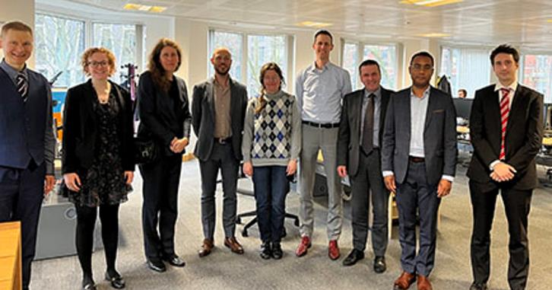
Engagement with international regulators
This includes:
  Second International Climate Change Meeting – January 2025.
    Involved nuclear regulators from France, Belgium, the Netherlands and Finland.
  Supporting French regulatory working group on air and water temperature.
  Presentation to Western European Nuclear Regulators’ Association (WENRA) in May 2025.
  International Atomic Energy Agency (IAEA) Conference on Resilience of Nuclear Installations against External Events from a Safety Perspective – Focus on Climate Change 2025 – planning to present on our regulatory work on climate change.
23

Slide 24
Fourth round of mandatory climate change adaptation reporting (1/2)
Defra (Department for Environment, Food & Rural Affairs) Adaptation Reporting Power (ARP)​ under the Climate Change Act 2008:
  Defra has been empowered by Government to require UK organisations (governmental organisations, statutory undertakers, regulators, some large cooperate organisations, etc) to report upon their preparedness for the potential effects of climate change.
  The information informs the UK Climate Change Risk Assessment (CCRA), which is updated on a five yearly basis (most recently CCRA3, 17th January 2022).
  For the fourth round of the Adaptation Reporting Power, ONR was invited to report on behalf of the GB nuclear industry. We agreed primarily on the basis that this supports our objective to be transparent with stakeholders.

Slide 25
Fourth round of mandatory climate change adaptation reporting (2/2)
ONR has recently published ONR’s response to the fourth round of climate adaptation reporting in accordance with the Adaptation Reporting Power: ONR’s response to the fourth round of climate adaptation reporting in accordance with the Adaptation Reporting Power (ARP) | Office for Nuclear Regulation
Primarily concentrates on external looking aspects (an industry overview).
Highlights the limits of our purposes in law and focus on these (the Environment Agency has contributed to previous rounds).
Draws heavily on the learning from the CNI Themed Inspection on climate change.
Only touches lightly on ONR’s plans for organisational resilience in light of climate change.
Concludes that, while the GB industry is currently resilient to the near-term effects of climate change, significant investment is required to ensure it will continue to satisfy our expectations in the future.
25

Slide 26
Engagement with other regulators
ONR has engaged with other regulators throughout the CNI Themed Inspection:
  We engaged with the environment agencies before the self-assessment questionnaire was issued to understand any potential areas of overlap with ongoing work on Control of Major Accident Hazards (COMAH) regulations and environmental permitting and links to climate change.
  For Scottish COMAH nuclear sites, the Scottish Environment Protection Agency (SEPA) has used the outputs from ONR’s self- assessment questionnaire, rather than these sites being asked to complete an additional questionnaire relating to COMAH.
  We invited attendees from the relevant environment agency to all five site-based inspections and the Defence Nuclear Safety Regulator attended the AWE inspection.
  We included a contribution from the Environment Agency in the Summary Report, with their findings from the inspections.
  As part of our forward work, we are identifying further opportunities for collaboration with other regulators including joint inspections and potential updates to joint guidance.

Slide 27
Questions/discussion

Slide 28
Break

Slide 29
Feedback Questions – NGO Forum - Session 2

Slide 30
Questions for discussion
What benefits do you think the climate change workshops have had on both ONR and yourselves?
Compared to the start of the climate change workshops, how would you describe your knowledge of ONR’s regulatory expectations for climate change? [Options - No improvement, limited improvement, some improvement, significant improvement]
What if any, specific topics or discussion do you feel have not been fully covered during the climate change workshops?
In terms of external hazards that could be affected by climate change, what do you think are the three dominant external hazards for GB nuclear sites?
How do you think ONR’s regulatory approach for climate change compares with other regulators, including our benchmarking approach?
How do you think the ONR external hazards team could apply the learning from working with other regulators to our regulatory activities going forward?
Do you use the ONR website to get information on our approach to climate change [Options – yes, no]
Considering the current information we publish on our website on our approach to climate change, is there anything additional that could be included?
Do you use our research briefings? [Options – yes, no]
Are there any topics that you would like to see in future ONR research briefings?
How would you like our research briefings to be circulated?
Do you have confidence that ONR effectively considers the potential impact of climate change in its regulation of the nuclear industry? [Options - Yes, No, Partly]

Slide 31
Question 1 – What benefits do you think the climate change workshops have had on both ONR and yourselves? (1/2)
“We have built a much closer and trusting relationship since the issue of Climate Change was raised by us in 2018.”
“The workshops enable the NGOs and ONR to communicate and question each other about the real practical problems of how problems relating to the rapidly changing climate tipping points need to be resolved”
“They have led to an increased understanding of some of the consequences of climate change.
They have resulted in joint ONR-NGO planning of workshops and activities.
They have helped us in working towards a more deliberative, participatory approach to examining problems together.
They have been a factor in encouraging ONR to undertake the CNI inspection on climate change issues.”

Slide 32
Question 1 – What benefits do you think the climate change workshops have had on both ONR and yourselves? (2/2)
“Clarity on climate change predictions and current. Better understanding of likely and actual impacts on nuclear licensed sites and potential mitigation/adaptation”
“Hopefully it has registered with ONR that people are concerned about Climate Change having an impact on the nuclear industry and that CC will be factored into any nuclear plans. This I believe has begun. This includes what has already been around for 60 years and the future generation. Opportunity to reassure the public through the workshops. Having a small window into the regulator gives an idea of how things work.”
“I have seen a shift in emphasis by the ONR on Climate Change”

Slide 33
Question 2 - Compared to the start of the climate change workshops, how would you describe your knowledge of ONR’s regulatory expectations for climate change?

Slide 34
Question 3 – What if any, specific topics or discussions do you feel have not been fully covered during the climate change workshops?
“Timescales of rapidly accelerating sea level rise! Interim storage of high level waste, over huge timescales! Availability of sufficient amounts of potable water. The society breakdown of the ability to safeguard waste due to lack of political resources and finances and engineering skills”.
“Very little was not covered and very little has changed that we are aware of apart from the new theme in the CNI’s Report”.
“I have not attended all the workshops so would be difficult to comment on this.
The fact that any regulations are always being worked on from previous data, ie. 2008. Needing to update all the time. With this in mind it shows how in time there is big change. Decisions are being made now for a distant future which is hard for any regulator. How can decisions be made ethically for the future?”
“We have not really covered what approach needs to be taken to address long term uncertainties, such as sea level change and societal breakdown and how these will impact on long term issues such as management of high level wastes.”

Slide 35
Question 4 - In terms of external hazards that could be affected by climate change, what do you think are the three dominant external hazards for GB nuclear sites? (1/2)
“Sea level rise (and storm surges etc.), cooling water temperature increases, atmospheric condition changes”
War/terrorism, very extreme weather events and inadequate emergency plans.”
“Sea level rise and storm surges and flash flood rainfall
Not building sea walls or not high enough and the builder, EDF not concerned about the coastlines outside of their build area, the impact to adjacent places considering the legacy waste that will be stored forever.
Heat affecting the electronics of the controls. The reliance on electronic communications.
Ultimately migration of vast numbers of people trying to survive, causing difficulties locally which impact the staff that has to run the power stations safely. Thinking wider picture here regulators remotely for example.”

Slide 36
Question 4 - In terms of external hazards that could be affected by climate change, what do you think are the three dominant external hazards for GB nuclear sites? (2/2)
“Sea level rise, fires, floods”
“Societal breakdown, sea level change and flooding, extreme weather events”
“Inundation of high level radioactive spent fuel.
  The ethics of leaving problem solving to be paid for by future generations.
  Lack of political will, finances, resources to deal with climate change problems, keeping population safe from radioactivity and radioactive waste.”

Slide 37
Question 4 – ONR’s response
From ONR’s perspective, the three dominant hazards for GB nuclear sites that could be affected by climate change are:
Temperature – High air temperature can impact nuclear safety related heating, ventilation and air-conditioning (HVAC) equipment, that supports operation of equipment if temperature limits are exceeded.
External flooding - Without adequate protection, flooding has the potential to inundate sites, affecting nuclear safety related plant. External flooding includes coastal, pluvial and fluvial flooding.
Wind – There is still some uncertainty about the impacts of climate change on wind. Some sites may have operating rules to stop or postpone activities if high wind speeds are forecast.

Slide 38
Question 5 - How do you think ONR’s regulatory approach for climate change compares with other regulators, including our benchmarking approach?
“I don't know enough about what other regulators do to answer this.”
“ONR does lead the way in trying to assess and discuss climate change problems. Other departments are restricted financially or politically influenced.”
“ONR regulating nuclear power is a whole different ball game to other regulators.”
“Not sure”
“Not sure”
“Better”

Slide 39
Question 5 – ONR’s response
We have held two meetings with European regulators from France, Belgium, Finland and the Netherlands on climate change to benchmark our approach. Other regulators are very interested in our work on climate change and are looking to learn from the recent CNI Themed Inspection.
We have presented the outputs of the CNI Themed Inspection to groups such as Western European Nuclear Regulators’ Association (WENRA) and International Nuclear Regulators' Association (INRA).
We are supporting a French regulatory working group on air and water temperature, sharing the learning from the UK.
We will be presenting at the IAEA Conference on Resilience of Nuclear Installations against External Events from a Safety Perspective – Focus on Climate Change later in 2025 to present our regulatory work on climate change.
There are opportunities to benchmark our regulatory expectations on external hazards and climate change with other regulators, particularly the US and Canada, in future Generic Design Assessments (GDA).
We are currently reviewing our Safety Assessment Principles and simplifying our guidance to make our regulatory expectations clearer. This will be informed by our benchmarking work.

Slide 40
Question 6 - How do you think the ONR external hazards team could apply the learning from working with other regulators to our regulatory activities going forward?
“Again, I don't know enough to answer this question.”
“Evaluate for civil/defence sites”
“Very little”
“Very little. See above. They could learn from ONR in respect to Health and Safety across the board as the consequences are so dangerous.”
“More visible collaboration”
“To be more open to share concerns that have been raised. Are there gaps between regulators that are not addressed? Use examples to illustrate the process maybe.”

Slide 41
Question 6 – ONR’s response
There are a few areas that we are looking to develop further now the CNI Themed Inspection on climate change has been completed:
More joint working with other regulators such as the environment agencies, Control of Major Accident Hazards (COMAH) regulations competent authority and Defence Nuclear Safety Regulator. For example, undertaking joint inspection/assessment activities where possible and appropriate to do so.
Review of joint regulatory guidance on climate change.
Engagement with other industries/fora such as COMAH Strategic Forum, Chemical and Downstream Oil Industries Forum, Health and Safety Executive.

Slide 42
Question 7 – Do you use the ONR website to get information on our approach to climate change?

Slide 43
Question 8 - Considering the current information we publish on our website on our approach to climate change, is there anything additional that could be included?
“Likely/possible impacts on each site and mitigating /adaptation scenarios/plans”
“Still looking at the 2024 document ……ARP It uses CC act 2008. Possibly as x and y changes it could feed in the latest information directly?”
“I think ONR still needs to develop and articulate a strategic approach to tackling climate change, rather than publishing random information on the topic.
Technical papers on the topic are always useful, but I think you already publish these.”
“Cannot comment”
“An update on policy advice being given to government and via the IAEA to all governments.”

Slide 44
Question 9 – Do you use our research briefings?

Slide 45
Question 10 - Are there any topics that you would like to see in future ONR research briefings?
“Need to look at them before commenting”
”Adaptation at defence sites”
“Find out how much MPs know about nuclear power and radiation.”
“Hazards to nuclear power plants during wartime”

Slide 46
Question 11 – How would you like our research briefings to be circulated?
“Newsletters with the findings in bullet points.”
“Email”
“Publicise in your regular email newsletter.”
“By email to concerned Nuclear NGOs”
“Regular notifications (email) to advise new briefing posted.”

Slide 47
Question 12 – Do you have confidence that ONR effectively considers the impact of climate change in its regulation of the nuclear industry?

Slide 48
Lunch

Slide 49
ONR’s Research on External Hazards – Recent updates

Slide 50
ONR-RRR-115 – Investigations of advances in climate science: tipping points, model uncertainty and compound events in the UK
ONR-RRR-115 follows on from ONR-RRR-055 – “Extreme Weather Events in the UK” that recommended conducting additional research on:
  Tipping points
  Compound flooding events
  Modelling uncertainty
One report was produced for each topic by an appropriate member of the ONR Expert Panel on Natural Hazards.
The purpose of the project was to:
  Determine the current scientific understanding of each topic.
  Provide technical advice to ONR in relation to these aspects.
  Highlight areas of uncertainty.
  Identify potential future developments.
The reports are available on our website:
https://www.onr.org.uk/publications/regulatory-reports/research/research-reports/onr-rrr-115

Slide 51
ONR-RRR-115 – Individual Reports (1/3)
Uncertainty in Climate Change Projections
Literature review based on peer-reviewed academic papers.
Focuses on future emissions scenarios, inherent uncertainty in the climate system, climate model uncertainty and how climate model uncertainty is dealt with.
Key findings:
  Climate models provide credible large-scale climate projections.
  Refining of climate models to make future projections more robust.
  Better understanding of climate model uncertainty will help risk management.

Slide 52
ONR-RRR-115 – Individual Reports (2/3)
Tipping Points in the Climate System
Literature review based on peer-reviewed academic papers.
Focuses on definition and history of tipping points, modelling and prediction of tipping points, tipping points and past climate change, tipping points and future climate change.
Key findings:
  The climate system is capable of rapid changes in its state.
  Understanding of the timing of these and their impacts is emerging (e.g., Atlantic Meridional Overturning Circulation).

Slide 53
ONR-RRR-115 – Individual Reports (3/3)
Compound Hazard Events
Literature review based on peer-reviewed academic papers.
Explores definition of a compound event and approaches to assessment typically used.
Considers existing design approaches and how compound events can impact performance of infrastructure.
Key findings:
  Temporally compounding events are an important consideration (e.g., Dawlish 2013/14).
  A single storm design basis may not be conservative given time-dependent deterioration of infrastructure.
  Potential focus on outcome performance rather than input loads.

Slide 54
ONR-RRR-142 – Review of high-end climate scenarios (1/2)
ONR has recently awarded a contract to a Technical Support Contractor for research on “high-end” (i.e., high impact, low-likelihood) climate scenarios (ONR-RRR-142).
ONR expects dutyholders to perform analysis of climate change using a range of climate scenarios, annual exceedance frequencies and sensitivity studies, including consideration of high-end climate change scenarios (such as credible maximum scenarios).
A challenge faced by dutyholders in the nuclear industry, other industries, and ONR is whether H++ scenarios remain appropriate for use as high end climate change scenarios, as these were not updated in UKCP18.
Current end date for project end 2025. Summary report expected to be published on website in 2026.

Slide 55
ONR-RRR-142 – Review of high-end climate scenarios (2/2)
The purpose of this research project is to enable ONR to better understand:
The range of high-end climate change scenarios currently available (or being developed/in publication), and recommendations regarding their applicability in a UK context.
Planned and potential research in relation to high-end climate change scenarios.
The research project will inform:
future updates to ONR’s guidance including ONR’s Technical Assessment Guide for External Hazards (NS-TAST-GD-013)
joint regulatory guidance on climate change
ONR’s expectations for dutyholder safety cases

Slide 56
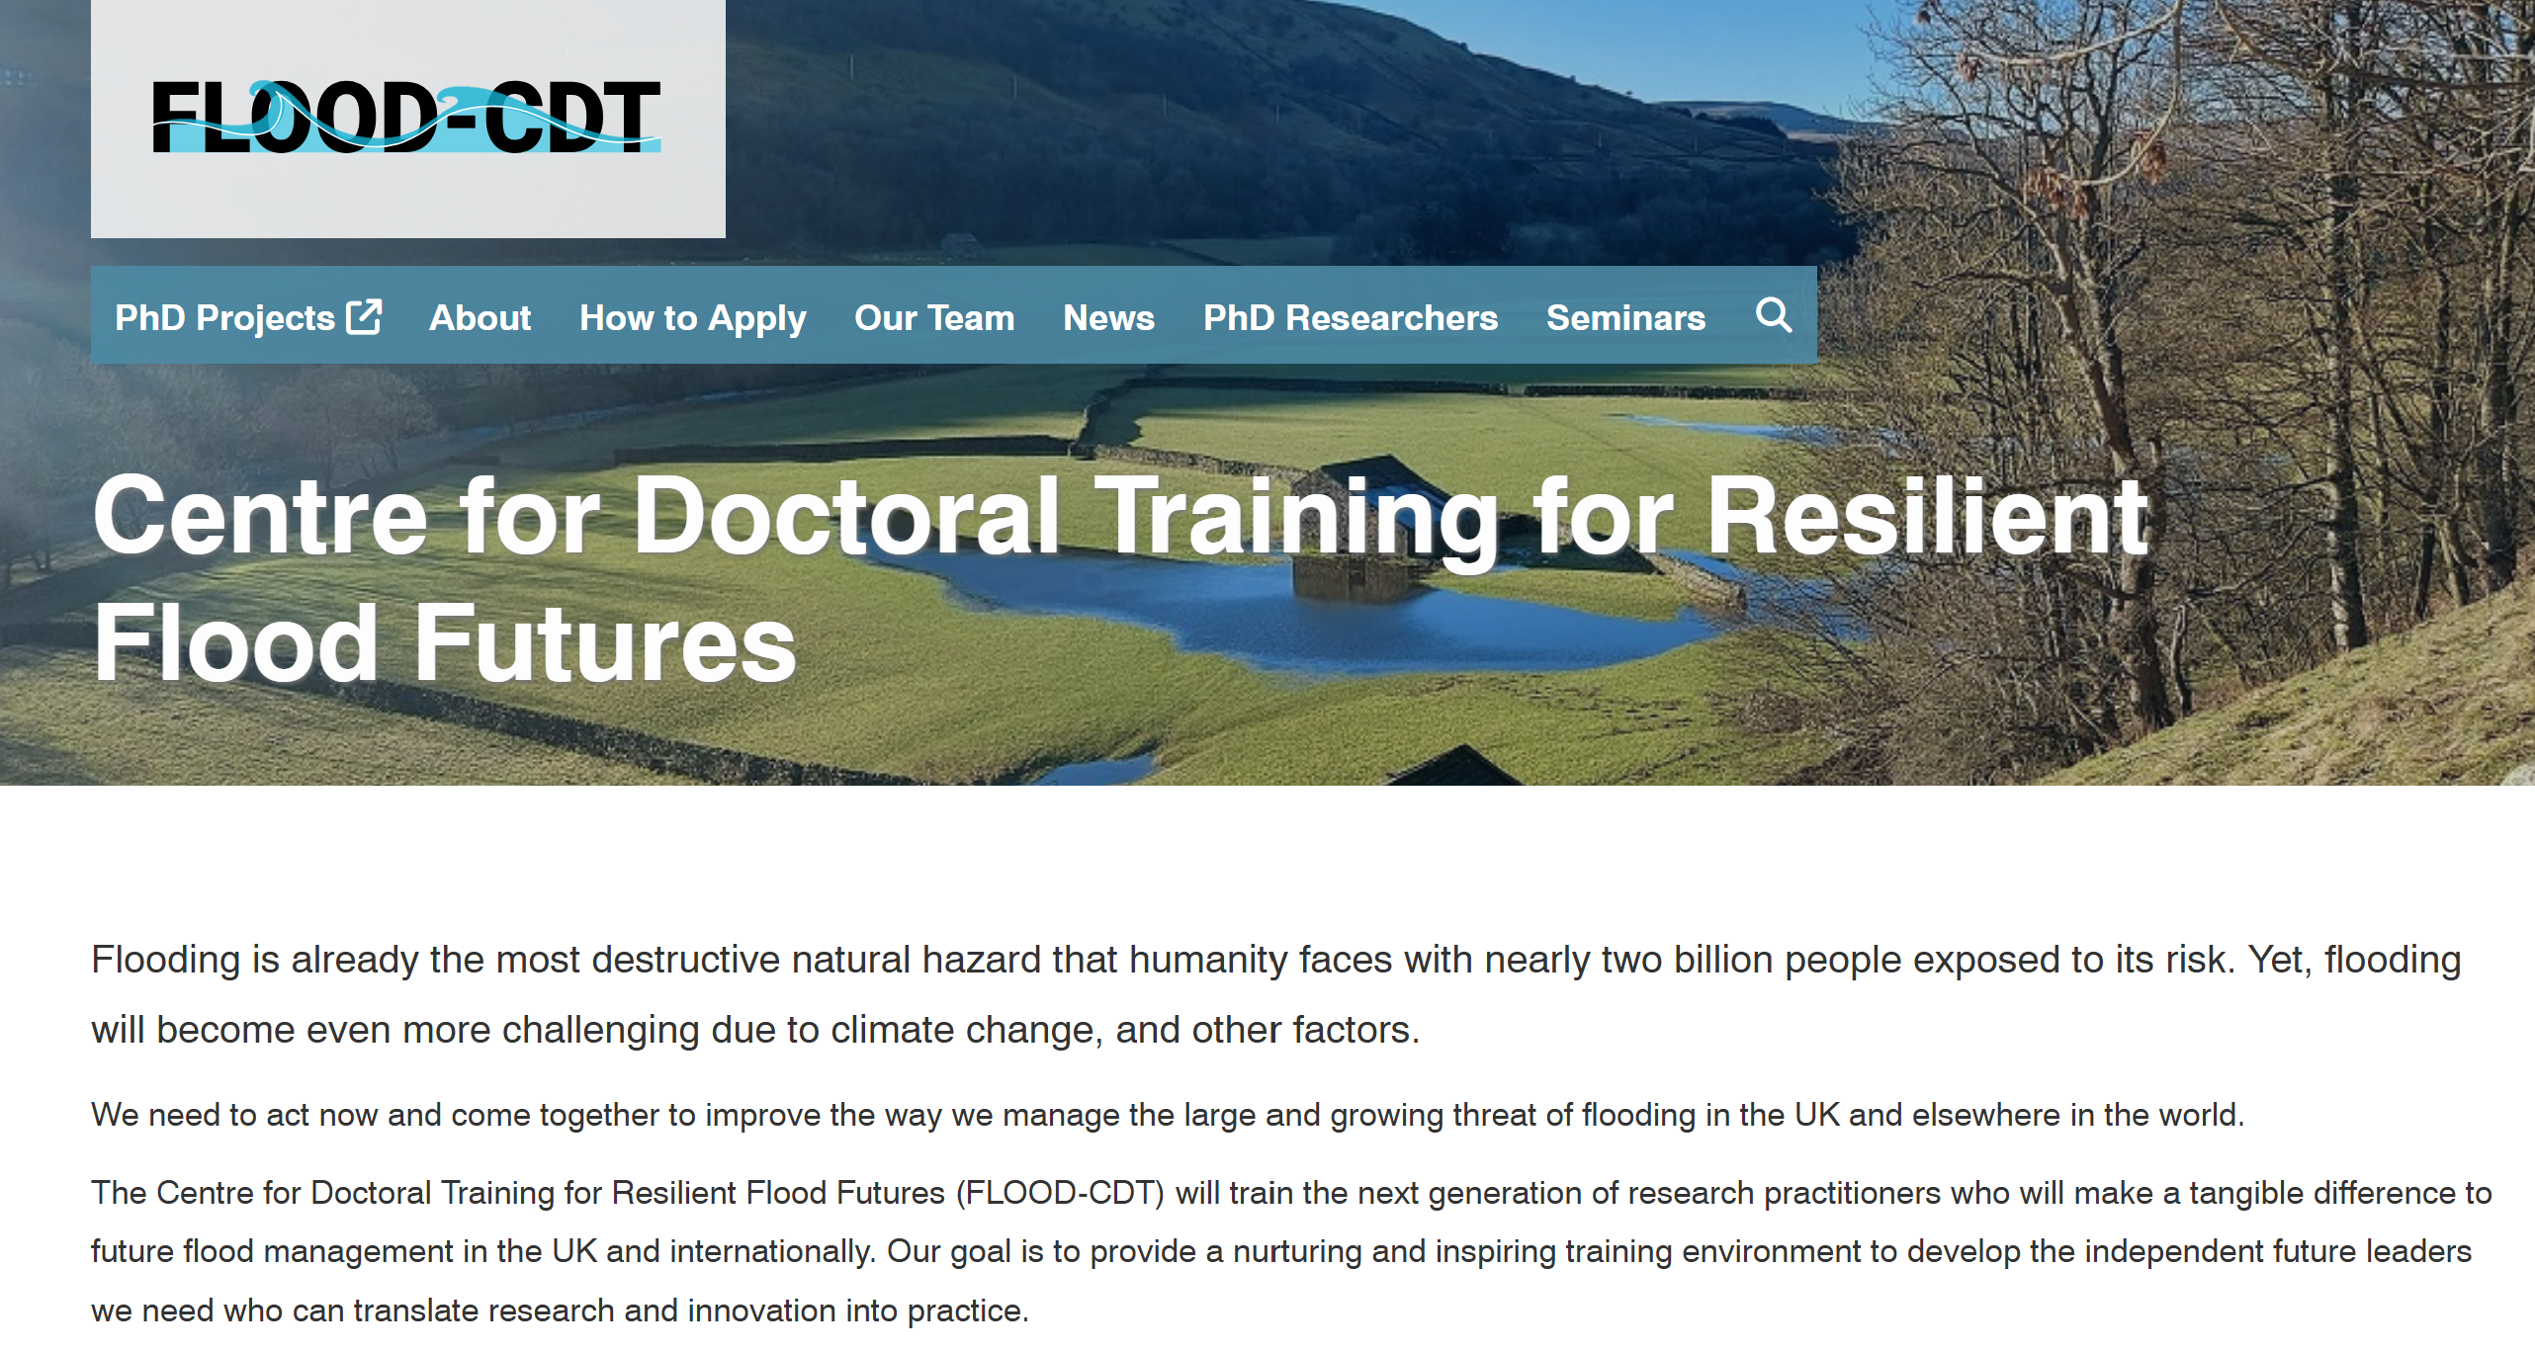
Future Research Opportunities
ONR will continue to commission research on climate science where appropriate, in accordance with our research strategy.
We are looking for relevant opportunities to sponsor PhD studies with FLOOD-CDT.
We are looking to collaborate with the Environment Agency on their research, where appropriate.
We will continue to use our Expert Panel to maintain a ‘watching brief’ on emerging climate science topics and commission research, where appropriate.

Slide 57
Future following climate change workshops – general discussion

Slide 58
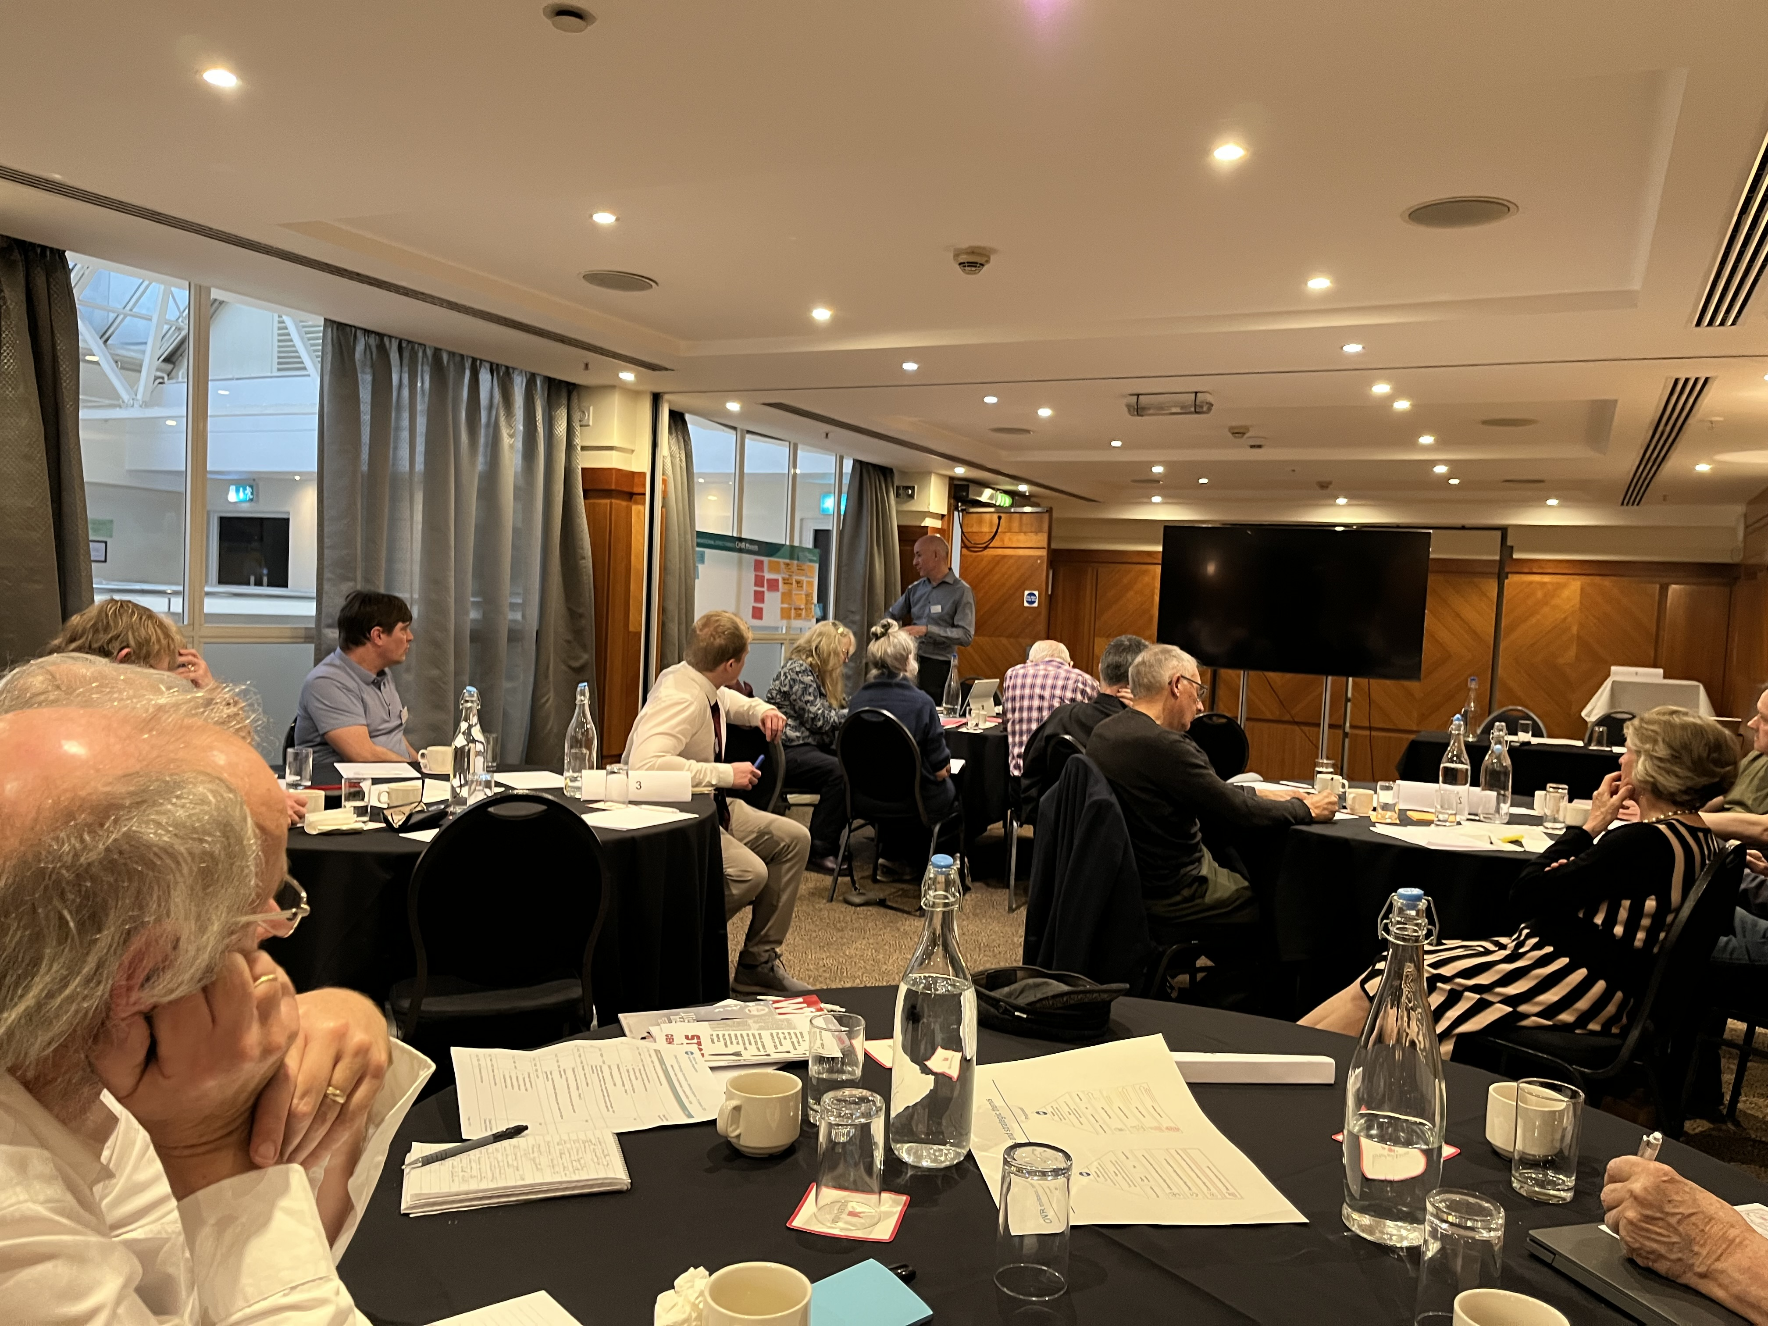
Questions to discuss on tables
What can we learn from our experience of the climate change workshops that should inform future forums?
What long-term impact topics might we want NGO forum to consider and do potential deep-dives on in the future?

Slide 59
Summary of the Day

