Slide 1
Regulatory Update Mark Foy Chief Executive and Chief Nuclear Inspector ONR NGO Forum 19 April 2023

Slide 2
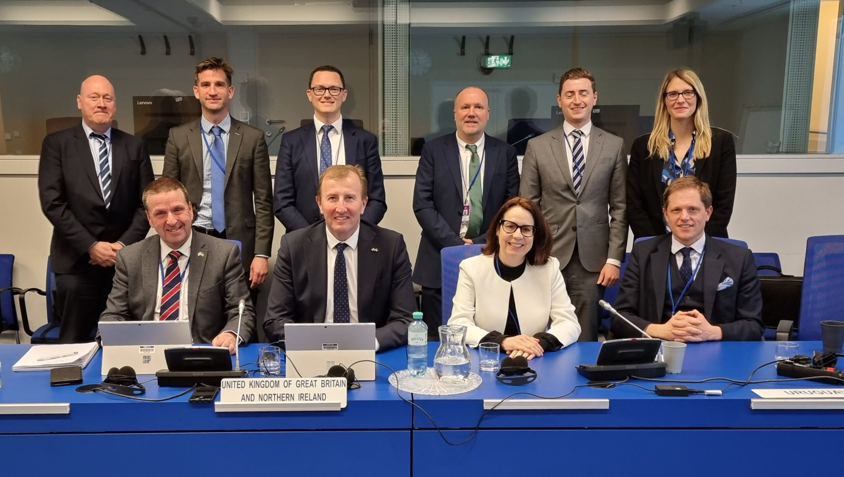
Regulatory update
Ethics – reflections, future way forward
Great British Nuclear – latest position
New Government Minister for Nuclear and Networks
EPR update – Fuel and IRSN reports
SDF ‘Good Practice Guide’ for SSGs/LLCs
CNI themed inspection – climate change
Convention on Nuclear Safety – Vienna
International collaboration

Slide 3
Donald Urquhart Executive Director of Regulation and Deputy Chief Nuclear Inspector ONR NGO Forum 19 April 2023

Slide 4
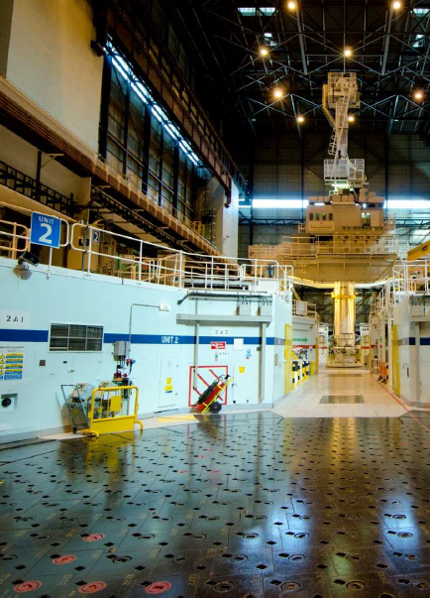
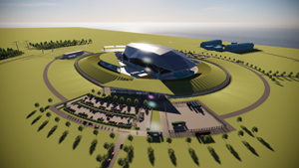
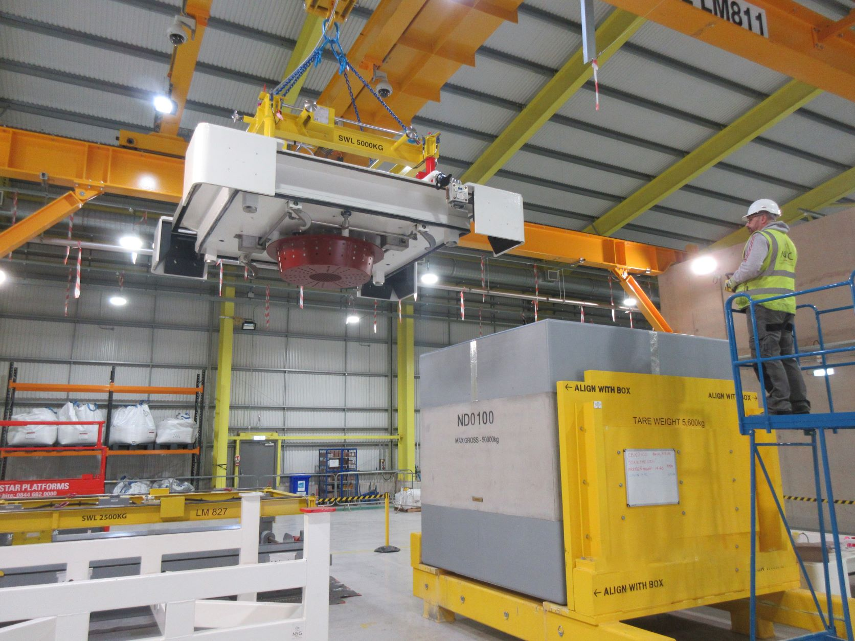
Regulatory update
New Reactors
Innovation
ASN-ONR co-operation/Sizewell B
Heysham 1 and Hartlepool lifetime extension
Engagement with environment agencies
Sellafield MSSS
Dounreay relicensing
Security and safeguards
Recent enforcement action

Slide 5
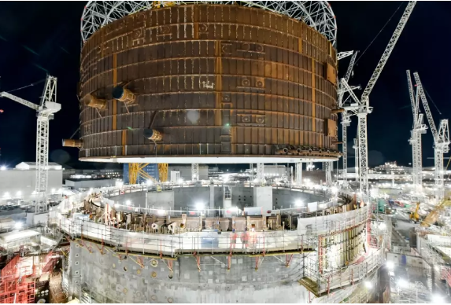
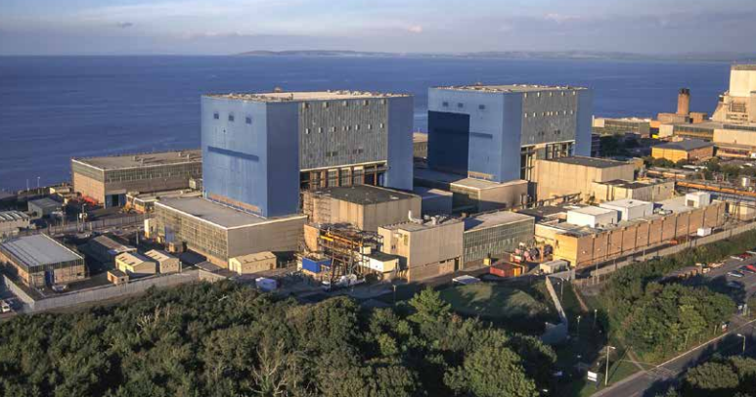
Areas of ONR regulatory focus over coming months - ARR
New Reactors Division (NRD) Conventional health and safety regulation Optimise GDA time frame International harmonisation |  | Operating Facilities Division AGR transition Sites in enhanced attention Defence infrastructure permissioning
 | Technical Division Efficiency of regulation Coordinate progress against CNI themes Embed and maintain WIReD processes
Civil Nuclear Security and Safeguards Industry cyber security performance Integration of security with operating divisions Review inspection practice proportionality |  | Sellafield, Decommissioning, Fuel and Waste Accelerated remediation at Sellafield Develop relationships with NDA and EA Review proportionality relative to hazard

Slide 6
Regulatory Directorate (RD) Priorities for 2023 - ARR
Hinkley Point C
Cyber security
AGR lifetime plans
Defence sites in enhanced attention
Generic design assessments
SDFW – legacy ponds & silos, special nuclear material

Slide 7
Thank you

Slide 8
Highlands Against Nuclear Power - Update Tor Justad ONR NGO Forum 19 April 2023

Slide 9
Lunch

Slide 10
ONR NGO Forum – Regulation of Defence Sites Mike Finnerty Director of Regulation, Operating Facilities Division 19 April 2023

Slide 11
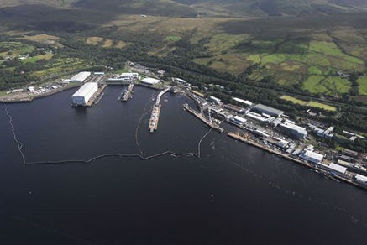
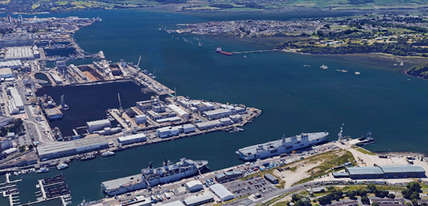
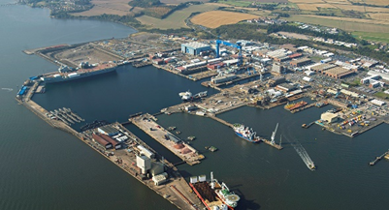
Overview of Defence Sites Regulated by ONR
Nuclear licensed sites:
Sites we regulate in accordance with the standard nuclear site licence (e.g. AWE, DRDL, RRSL, BAES and RRSL);
Authorised sites:
Do not require a nuclear site licence because of exemptions relating to specific activities or disapplication under Crown control (e.g. parts of Devonport);
Nuclear warship sites:
ONR is enforcing authority for REPPIR 2019 and IRR 2017.

Slide 12
Regulatory Attention Levels for Nuclear Licensed Sites
DRDL Devonport and AWE Aldermaston remain in enhanced attention:
Areas of focus for ONR being leadership, organisational capability and decision making (DRDL) and duty-holder compliance, delivery and organisational capability (AWE);
AWE Burghfield recently moved back to routine attention;
Remaining Nuclear Site Licensees, i.e. RRSL Derby, BAES Barrow and RRDL Rosyth all currently in routine attention.

Slide 13
Regulatory Enforcement Action
AWE Aldermaston – MPF Prohibition Notice
Prevents entry into the ground floor of the Main Production Facility unless a safe system of work is in place that renders work in the area safe; the PN will remain in place for as long as the confined space exists.
DRDL Devonport – Electrical Safety Improvement Notice
Requires DRDL to implement long-term, sustainable measures to control work on electrical and stored energy systems; good progress but extended until June 2023.
Babcock Marine (Clyde) – Battery Replacement Improvement Notice
Implementation of a safe system of work for managing risks associated with the battery replacement activity. Very positive response, including leadership and positive impact on safety culture enabled closure one month early.

Slide 14
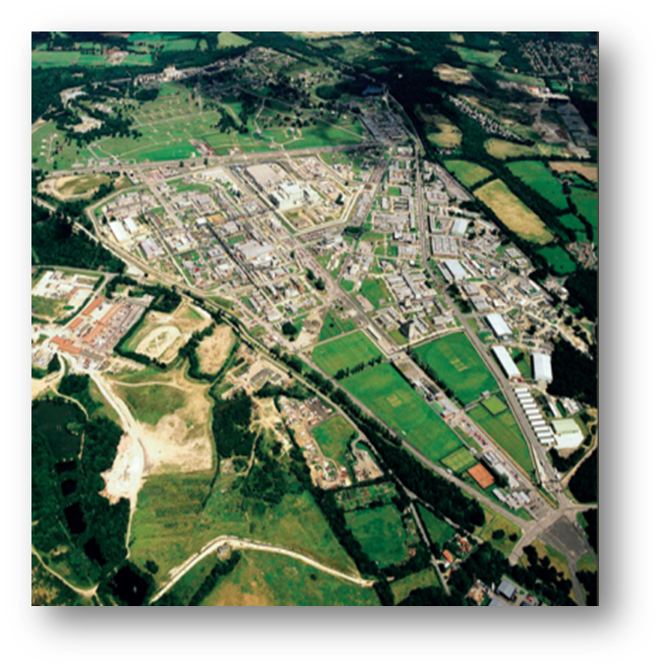
Areas of Regulatory Focus 1
For AWE major programmes of work ahead include:
Decommissioning legacy facilities
Upgrading current ageing operational facilities
Delivering new build facilities to support future programme
Further challenge for AWE is to build the capability and capacity needed to meet these objectives.
Management of ageing plant and industrial safety compliance are also areas of close regulatory attention.

Slide 15
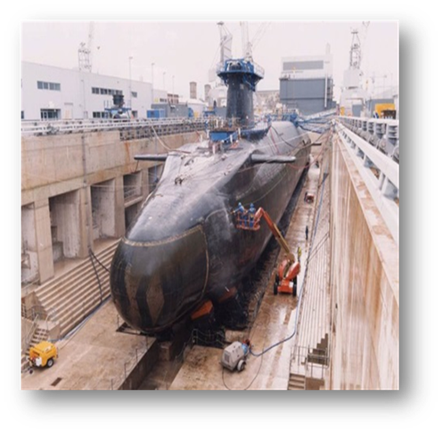
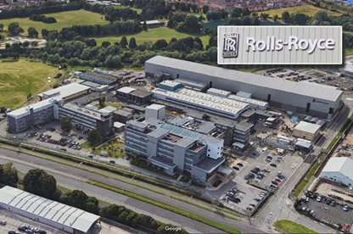
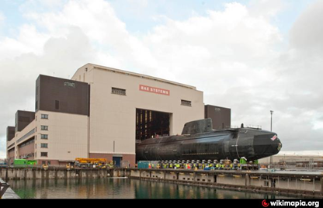
Areas of Regulatory Focus 2
Propulsion licensees also faced with significant programmes of work ahead including:
Astute, Dreadnought and AUKUS submarine campaigns involving BAES and RRSL
Major refurbishment of docking facilities and decommissioning legacy submarines at Devonport
Challenge for propulsion licensees to build the capability and capacity needed to meet these objectives.
Management of ageing plant and industrial safety compliance are also areas of attention for DRDL.

Slide 16
VIRES Review
Review of regulatory vires across defence sector was a significant legal and policy review to provide assurance that ONR is discharging its statutory safety purposes in an appropriate manner;
Review concluded this is the case and ensured that all parties had greater clarity of each other’s areas of responsibility;
Review highlighted some areas where further constructive working between ONR and the Defence Nuclear Safety Regulator would be beneficial;
Specific areas of activity have been identified and will be captured as case studies to be included in a refreshed General Agreement between ONR and MoD;
Further output from review has been creation of a pan-enterprise strategic forum that is fostering a more positive working relationship and helping further cement effective regulation of the sector.

Slide 17
Refreshments

Slide 18
ONR NGO Forum - New Nuclear National Policy Statement (NPS) Kobina Lokko ONR Senior Policy Advisor ONR NGO Forum 19 April 2023

Slide 19
NPS to 2025
National Policy Statements (NPS) - delivering the energy infrastructure needed for the transition to net zero.
Current nuclear NPS (EN-6) - Government’s planning policy for siting nuclear electricity generating infrastructure up to 2025.

Slide 20
Policy intent
Written questions, answers and statements - UK Parliament
UIN 156139, tabled on 1 March 2023.
DESNZ minister Andrew Bowie,
“The Government will also develop a new National Policy Statement, which will cover the siting and policy framework for nuclear electricity generating infrastructure, including SMRs, beyond 2025 and will consult on this in due course.”

Slide 21
New NPS
The new NPS will cover the policy framework for deploying new nuclear power stations beyond 2025
Support the UK in meeting the ambition of reaching up to 24GW of nuclear energy by 2050, as set in the British Energy Security Strategy (BESS).
Could include greater flexibility in the approach to siting new nuclear developments, including the potential deployment of advanced nuclear technologies such as Small Modular Reactors (SMRs).
Stepwise government policy process:
Consult later this year on how best to determine how new nuclear developments might be located;
Consult on the new nuclear NPS in due course;
Intent to designate the NPS following parliamentary scrutiny;
Planning policy to be in place for the deployment of nuclear project beyond 2025

Slide 22
ONR’s contribution
Advice on the development of policy options on siting criteria for the new nuclear NPS.
Advice on development of consultation on siting approach for new nuclear NPS.
Advice and participation in support of stakeholder engagement.

Slide 23
ONR’s contribution …continued
Key considerations we will communicate with regards to siting of new nuclear power stations:
Climate change
Flood risk
Platform height
Multi-facility sites
Third party sea defences

Slide 24
Basis for ONR’s advice
Translating technical matters for government policy makers.
Knowledge of technologies being viewed by ONR’s New Reactors Division.
Recognised expertise we can bring to bear.

Slide 25
ONR climate change workshops
An issue of key importance and mutual interest/concern to both ONR and the NGO community.
Initial workshop in October 2022 to hear the views of the NGO community and allow for constructive and open challenge.
Focus of subsequent meetings TBC. Current intention is to take specific stages of ONR’s permissioning of nuclear sites to explain ONR’s activities and processes and discuss in detail.

Slide 26
Thank you 2
Reflections? Observations? Questions?

